Slide 1
Spark on HDInsight Spark Architecture
Ali Zaidi
Data Scientist
Machine Learning Education Team

Slide 2

Learning objectives
Spark Deployment Modes
Spark Architecture
Physical Query Execution
Spark Application Submission

Slide 3
Spark Cluster Modes
We’ve discussed Spark Core Components
But how do we launch and run applications on these core components?
Three different types of cluster managers:
Spark Standalone
Mesos
YARN
Cluster Manager provides resources
Recall from before, for YARN, the resource manager will allocate YARN containers
Spark’s executors run inside these YARN containers
Executors run computations and store data for your application
Application code (JAR or Python/R scripts to Spark Session) to the executors.
Driver sends tasks to the executors to run

Slide 4
Spark Run Time Architecture
Worker Node
Executor1
Cache
Task
Task
Driver Program
Spark Context
Cluster Manager
Worker Node
Executor2
Cache
Task
Task

Slide 5
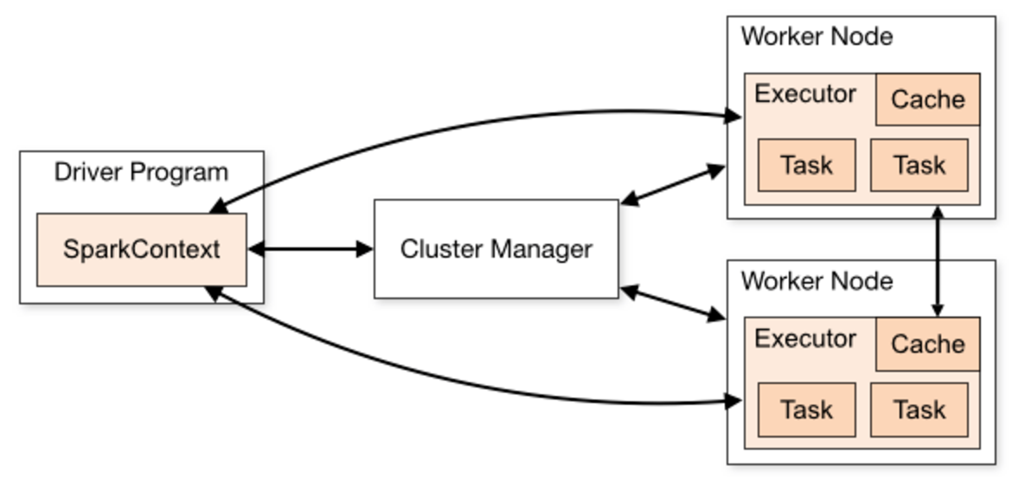
Spark Applications
Spark Applications can contain a variety of workloads and parameters
But they always have the following configuration
A driver process
Maintaining information about the Spark application
Responding to a user’s program
Analyzing, distributing, and scheduling work across the executors
A set of executor processes
Executing code assigned to it by the driver program
Reporting the state of the computation back to the driver program
Note:
In YARN, you have two configuration modes:
Cluster-mode: driver runs in application master on one of the nodes
Client-mode: driver runs in client, AM only needed for YARN requests

Slide 6
Spark Cluster Modes
As mentioned before, Spark users a cluster manager to acquire resources for execution
Worker
Worker
Worker
Executor
Executor
Executor
Containers
Application Master
Containers
Node Manager
Node Manager
Resource Manager
Client (Spark)
Driver
Master
Spark Standalone
Spark on YARN
Notes:
Using Spark Standalone
Install spark binaries on all worker nodes
Spark applications on standalone contain driver, executor, tasks
Driver connects to cluster using Spark Session
Spark Sessions uses master to acquire compute resources on workers
Spark session launches executors on worker nodes and sends application code (as tasks) through driver
Started using launch scripts (start-master.sh), uses conf file containing hostnames in Spark directory
Using YARN
Client application submits a job to the resource manager (i.e., a spark submit script)
Application master created per application
Application master negotiates resources with the RM. RM Creates containers on nodes
AM works with NMs to execute jobs in containers
AM runs on one of the machines running a NM

Slide 7
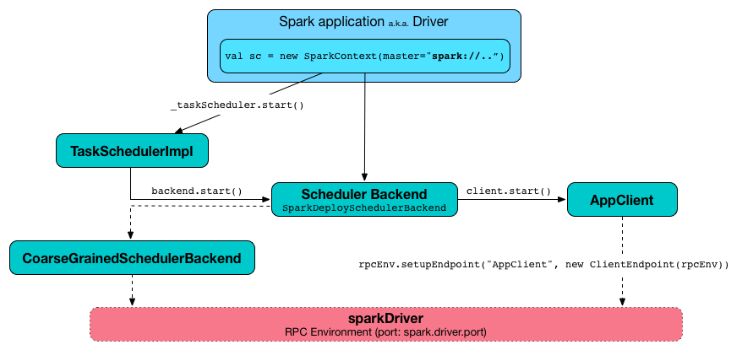
Launching the Spark In Standalone Mode
In standalone mode, Spark uses a Master daemon to coordinate with workers, which run the executors.
Standalone mode is the default, but cannot be used on secure clusters.
When you submit an application, you can choose how much memory its executors will use, as well as the total number of cores across all executors.
Notes:
Objective: This slide introduces the types and uses of RDDs.
Talking points:
The primary abstraction is Spark, a fault-tolerant collection of elements stored in-memory or on-disk that can be operated on in parallel.
Two types:
Parallelized collection: apply a parallel transformation to an existing Scala collection; users must specify the number of partitions.
Hadoop data set: run functions on each record of a file in HDFS or any other storage system supported by Hadoop.
Can be persisted in-memory across operations. When an RDD is persisted, each node stores any partitions of it that it computes in-memory and then reuses them in other actions on the data set.
Can mark an RDD as persistent just by calling the persist() or cache() method.
Can specify the storage level: on-disk or in-memory as a serialized Java object.
Cached or persistent RDDs are fault tolerant without replication.
Each RDD maintains its lineage (example: the sequence of transformations that resulted in the RDD).
If an RDD is lost because a node crashed, it can be reconstructed by replaying the sequence of operations.

Slide 8
Spark on YARN Mode
In YARN mode, the YARN ResourceManager performs the functions of the Spark Master.
The functions of the workers are performed by the YARN NodeManager daemons, which run the executors.
YARN mode is a bit more complex than standalone mode, but can be much more secure
Two modes of running a Spark Application in YARN: client mode, cluster mode
Client Mode: runs in the foreground (-deploy-mode cluster)
Cluster Mode: runs in the background (-deploy mode client)
A little more complex than client mode, but allows user to log out without terminating the application
Notes:
Objective: This slide introduces the types and uses of RDDs.
Talking points:
The primary abstraction is Spark, a fault-tolerant collection of elements stored in-memory or on-disk that can be operated on in parallel.
Two types:
Parallelized collection: apply a parallel transformation to an existing Scala collection; users must specify the number of partitions.
Hadoop data set: run functions on each record of a file in HDFS or any other storage system supported by Hadoop.
Can be persisted in-memory across operations. When an RDD is persisted, each node stores any partitions of it that it computes in-memory and then reuses them in other actions on the data set.
Can mark an RDD as persistent just by calling the persist() or cache() method.
Can specify the storage level: on-disk or in-memory as a serialized Java object.
Cached or persistent RDDs are fault tolerant without replication.
Each RDD maintains its lineage (example: the sequence of transformations that resulted in the RDD).
If an RDD is lost because a node crashed, it can be reconstructed by replaying the sequence of operations.

Slide 9

“The key to tuning Spark apps is a sound grasp of Spark’s internal mechanisms”
- Patrick Wendell, Databricks Founder, Spark Committer

Slide 10
Terminology
Job: The work required to compute an RDD
Stage: A wave of work within a job, corresponding to one or more pipelined RDD’s
Tasks: A unit of work within a stage, corresponding to one RDD partition
Shuffle: The transfer of data between stages

Slide 11
Spark Driver, Executors, Stages, and Tasks
Spark Driver – runs on the master node and declares transformations and actions on the data.
Driver creates the SparkContext/Spark Session, connected to a given Spark Master.
As you submit transformations on RDDs, Spark keeps track of the lineage graph
Accumulators – provide a simple syntax for aggregating values from worker nodes back to the driver program.
Broadcast variables – a second kind of shared variable, allows Spark to efficiently send a large, read-only value to all the worker nodes for use in one or more Spark operations.
Pipe: a method on RDDs that allow us to write parts of jobs with any language we wat as long as it can read and write to Unix standard streams.
Notes:
* The driver also delivers the RDD graphs to master.
* As you submit transformations on RDDs, Spark keeps track of the lineage graph, i.e., the set of dependencies between RDDs and contains all the information to compute each RDD on demand in case of recovery.
&

Slide 12
Spark Driver, Executors, Stages, and Tasks
Executors – worker processes responsible for running the individual tasks in a given Spark job.
Executors have two roles
Run the tasks that make up the application and return the results to the driver
Provide in-memory storage for RDDs that are cached by user programs.
Job: The work required to compute an RDD
Stage: A wave of work within a job, corresponding to one or more pipelined RDD’s
Tasks: A unit of work within a stage, corresponding to one RDD partition
Shuffle: The transfer of data between stages
Notes:
Executors are launched once at the beginning of a Spark application and typically the run for the entire lifetime of an application

Slide 13
Physical Execution of an Application
When you submit a Spark Application, the program gets translated into a physical execution
Application -> Jobs -> Stages -> Tasks
Spark Application
…
Invoked by an Action
Job
Job
Stages
Stages
Stages
Stages

Slide 14

Scheduling Process
RDD Objects
DAG Scheduler
Task Scheduler
Executor
TaskSet
Task
DAG
Task Scheduler
Task threads
Block manager
Rdd1.join(rdd2)
.groupBy(…)
.filter(…)
Split graph into stages of tasks
Submit each stage as ready
Launches individual tasks
Retry failed or straggling tasks
Execute tasks
Store and serve blocks
- Build operator DAG
Notes:
Q) Does every Action in Spark result in exactly one Job being run in the execution environment?
No.
Q) Can a Action sometimes result in multiple Jobs being run? When? Why? Is this determined by the complexity of the DAG above the RDD on which I called Action or something else?
Yes. For example, take can fire multiple jobs. It tries to fetch data from the 1st partition with a job, and if it doesn't have enough data, it fetches from more partitions.
Q) On a different note, inside of a job, is it true that sometimes stages run in serial, one after another... and other times 2 stages can run in parallel?
Yes. For example a join. The two input stages can run in parallel.
Jobs: Work required to compute RDD in runJob.
Stages: A wave of work within a job, corresponding to one or more pipelined RDD’s.
Tasks: A unit of work within a stage, corresponding to one RDD partition.
Shuffle: The transfer of data between stages.
A stage corresponds to a collection oftasks that all execute the same code, each on a different subset of the data. Each stage contains a sequence of transformations that can be completed without shuffling the full data.
The set of stages produced for a particular action is termed a job . In each case when we invoke actions such as count , we are creating a job composed of one or more stages.
Once the stage graph is defined, tasks are created and dispatched to an internal scheduler
which varies depending on the deployment mode being used. Stages in the physical plan
can depend on each other, based on the RDD lineage, so they will be executed in a
specific order. For instance a stage that outputs shuffle data most occur before one that
relies on that data being present.

Slide 15
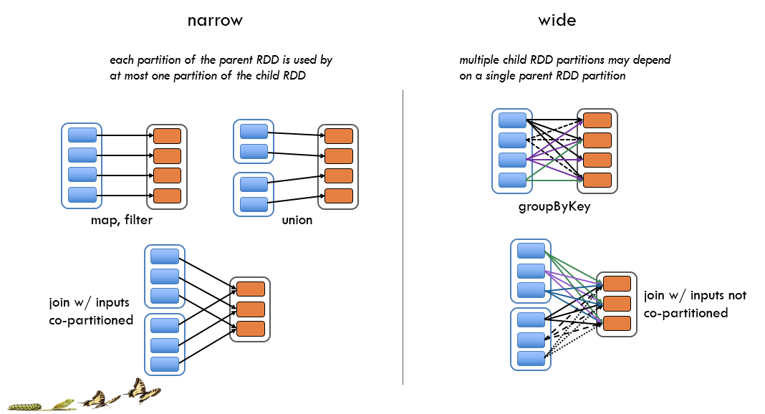
Narrow vs. Wide Dependencies
Notes:
The DAG Scheduler only understands narrow vs. wide dependencies… so shuffle stage boundaries…
The DAG Scheduler splits the graph into multiple stages. Stage boundaries are wide dependencies (so operations that you cannot pipeline).
Narrow dependencies
– allow for pipelined execution on one cluster node
– easy fault recovery
• Wide dependencies
– require data from all parent partitions to be available and to be shuffled across the nodes
– a single failed node might cause a complete reexecution.

Slide 16

© 2016 Microsoft Corporation. All rights reserved. Microsoft, Windows, Windows Vista and other product names are or may be registered trademarks and/or trademarks in the U.S. and/or other countries.
The information herein is for informational purposes only and represents the current view of Microsoft Corporation as of the date of this presentation. Because Microsoft must respond to changing market conditions, it should not be interpreted to be a commitment on the part of Microsoft, and Microsoft cannot guarantee the accuracy of any information provided after the date of this presentation. MICROSOFT MAKES NO WARRANTIES, EXPRESS, IMPLIED OR STATUTORY, AS TO THE INFORMATION IN THIS PRESENTATION.

